Slide 1
Automation Framework
Ruby - Capybara - RSpec - Site_Prism
Drivers: Poltergeist - Selenium Webdriver
Browsers: PhantomJS, Firefox, Chrome, Safari...

Slide 2
Automation Framework Goals
Having the ability to easily create simple automated tests that use the framework
Automated tests should be simple to write and maintain
It is always a better choice to put the complexity into the framework instead of into the tests.
When the application changes, not all tests need to be updated
Tests will need to change, automation framework should support and facilitate change
Tests can be group into suites
Having configurable test environments
Tests can be executed against local, qa, or production environment
Tests can be executed on build machine, or dev Mac, Linux, Windows

Slide 3
5-Ys
Ruby?
Simplicity and productivity - elegant syntax that is natural to read and easy to write
Capybara?
Backend switching - tests run against from fast headless mode to an actual browser with no changes to your tests
Powerful synchronization - not have to manually wait for asynchronous processes to complete
RSpec?
BDD practice - human readable specifications with built-in custom matchers for Ruby
Site_Prism?
Simple, clean and semantic for describing your site using the Page Object Model pattern
Page object with custom element, element collections, section, section collections and many built-in helper methods
PhantomJS?
A fast / headless WebKit that works well in continuous integration environment

Slide 4
References
Ruby - https://www.ruby-lang.org
Capybara - https://github.com/jnicklas/capybara
RSpec - http://betterspecs.org
Site_prism - https://github.com/natritmeyer/site_prism
PhantomJS - http://phantomjs.org/

Slide 5
Test environment setup
Prerequisites:
ruby-2.1.0 (rvm install 2.1.0)
phantomjs (brew install phantomjs)
chromedriver (brew install chromedriver)
Setup:
Goto webdriver directory, then install all gem bundles from Gemfile (bundle install)
Setup test env in config/capybara.yml with specific host url and settings

Slide 6
What to include
Gemfile
gem 'selenium-webdriver'
gem 'poltergeist'
gem 'rspec', '~> 2.14.1'
gem 'capybara'
gem 'site_prism'
spec_helper.rb
require 'capybara/rspec'
require 'capybara/poltergeist'
require 'selenium-webdriver'
require 'site_prism'

Slide 7
Run tests with rspec command
rspec (run all specs against default TEST_ENV)
TEST_ENV=qa-phantom rspec (run all specs against https://qa.gallery.brightcove.com on phantom browser)
TEST_ENV=qa-firefox rspec (run all specs against https://qa.gallery.brightcove.com on firefox browser)
TEST_ENV=qa-chrome rspec (run all specs against https://qa.gallery.brightcove.com on chrome browser)
TEST_ENV=prod-phantom rspec (run all specs against https://gallery.brightcove.com on phantom browser)
TEST_ENV=prod-firefox rspec (run all specs against https://gallery.brightcove.com on firefox browser)
TEST_ENV=prod-chrome rspec (run all specs against https://gallery.brightcove.com on chrome browser)
TEST_ENV=dev-phantom rspec (run all specs against http://localhost:3000 on phantom browser)
TEST_ENV=dev-firefox rspec (run all specs against http://localhost:3000 on firefox browser)
TEST_ENV=dev-chrome rspec (run all specs against http://localhost:3000 on chrome browser)
TEST_ENV=dev-chrome rspec spec/specs/sites/sites_edit_spec.rb (run a specific spec file)

Slide 8
Run tests with rake tasks
Run test suites with rake, auto retry failed spec
rake -T (build/list all rake tasks)
rake spec:suite:all (run all spec suites against default TEST_ENV)
rake spec:suite:sites (run sites spec suite against default TEST_ENV)
TEST_ENV=qa-phantom rake spec:suite:sites (run sites spec suite against qa-phantom TEST_ENV)

Slide 9
Demo and Code examples

Slide 10
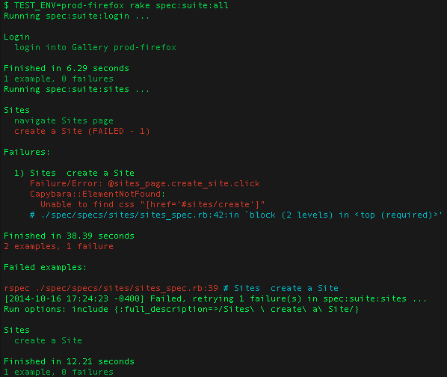
Run tests...

Slide 11
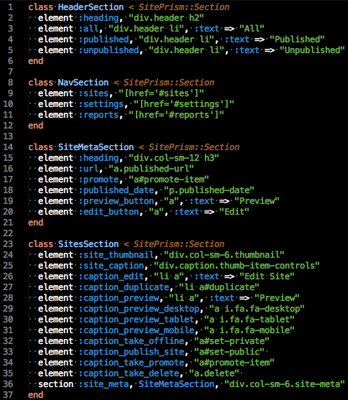
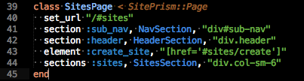
Gallery Sites Page
Sites_page.rb that includes multiple sections
Sections within Sites page ->

Slide 12
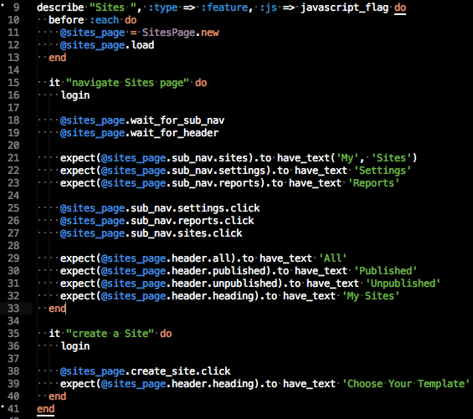
Sites_spec.rb

Slide 13
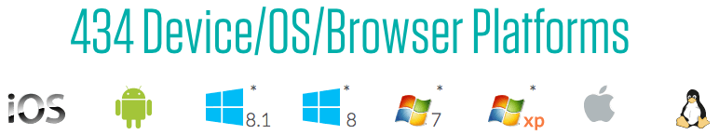
What’s Next
Here are some possible enhancements to the automation framework
Cross-browser support with Saucelabs / BrowerStack cloud-base environments
Run specs on almost any browser and device combination using the Selenium webdriver

Slide 14
Thank you
Khai Pham
kpham@brightcove.com

